Slide 1
React Web Applications Master Class
Architecture in Web Applications
SoftUni Team
Technical Trainers
Software University
http://softuni.bg

Slide 2



Learn to Search in Internet
The course assignments require to search in Internet
This is an important part of the learning process
Some exercises intentionally have no hints
Learn to find solutions!
Software development includes everyday searching and learning
No excuses, just learn to study!
Developers learn new technologies, tools, languages every day!

Slide 3
Definition of Architecture
The Important Stuff

Slide 4
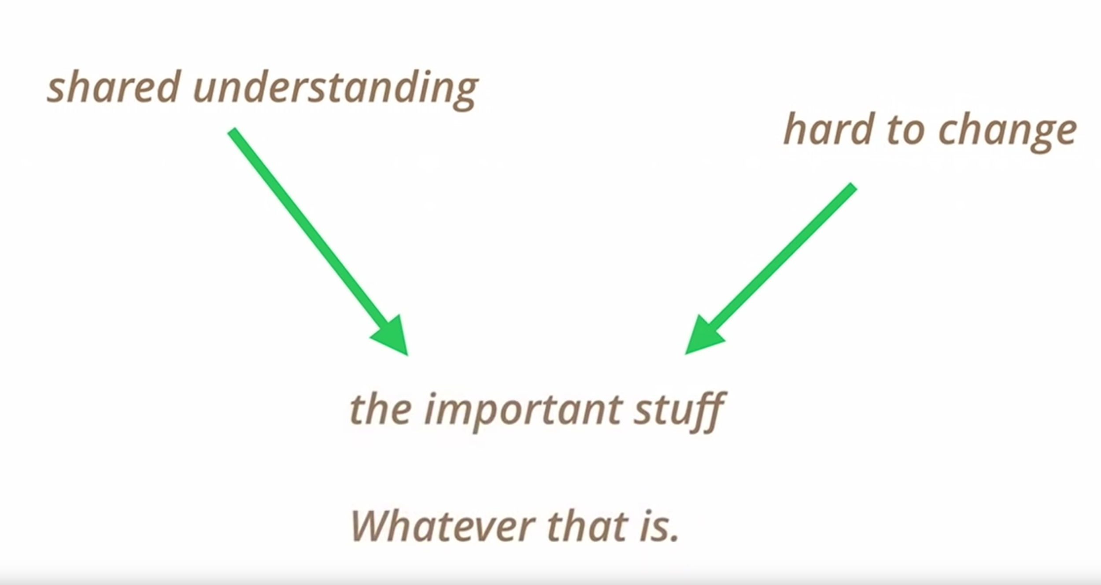
Making Architecture Matters*

Slide 5
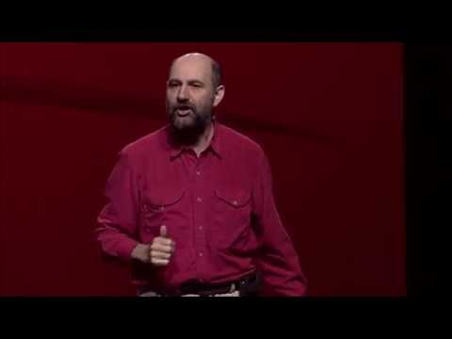
Making Architecture Matters

Slide 6
Table of Contents
The Twelve-Factor App
React Best Practices

Slide 7
The Twelve-Factor App

Slide 8
What is it?
A methodology for building software-as-a-service apps*

Slide 9
Twelve-Factor App Concepts
Declarative Formats
Clean Contract - Maximum Portability
Cloud Friendly
Minimize Divergence - Continuous Deployment
Scalable

Slide 10
Motivation
To raise awareness of some systemic problems in modern application development, to provide a shared vocabulary for discussing those problems, and to offer a set of broad conceptual solutions to those problems with accompanying terminology*

Slide 11
1. Codebase
A collection of source code used to build a particular software system, application, or software component.*

Slide 12
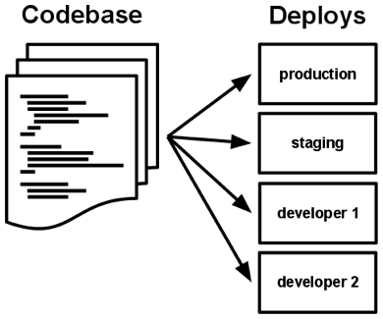
1. Codebase
One codebase tracked in revision control, many deploys
∈ VCS (Git, Mercurial, etc)
One Codebase - One App
One App - Many Deploys
Codebase is the same across all deploys

Slide 13
2. Dependencies
Explicitly declare and isolate dependencies
⊥ implicit global packages/system tools
Dependency declaration manifest
Dependency isolation
Full and explicit dependencies specification to both production and development

Slide 14
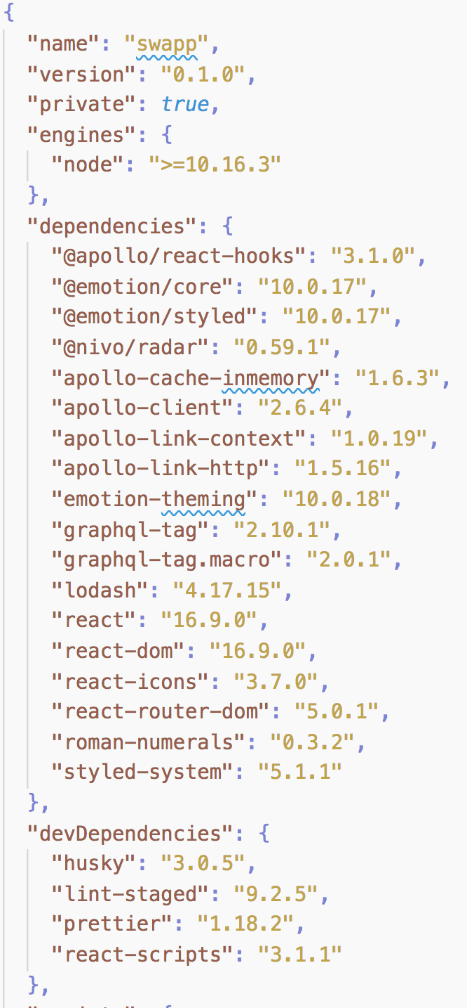
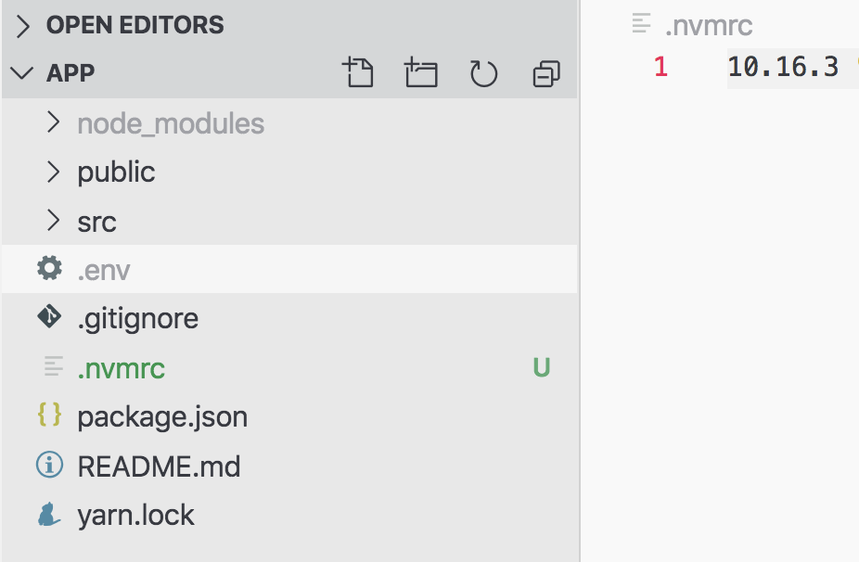
2. Dependencies in React
Explicitly declare and isolate dependencies

Slide 15
3. Config
An app’s config is everything that is likely to vary between deploys (staging, production, developer environments, etc) including resource handles to database, backend services, external services credentials, pre-deploy values, etc.*

Slide 16
3. Config
Store config in the environment
Strictly ∉ code
∉ VCS
Can codebase be open-sourced at any moment
∌ internal application config
Use Environment Variables

Slide 17
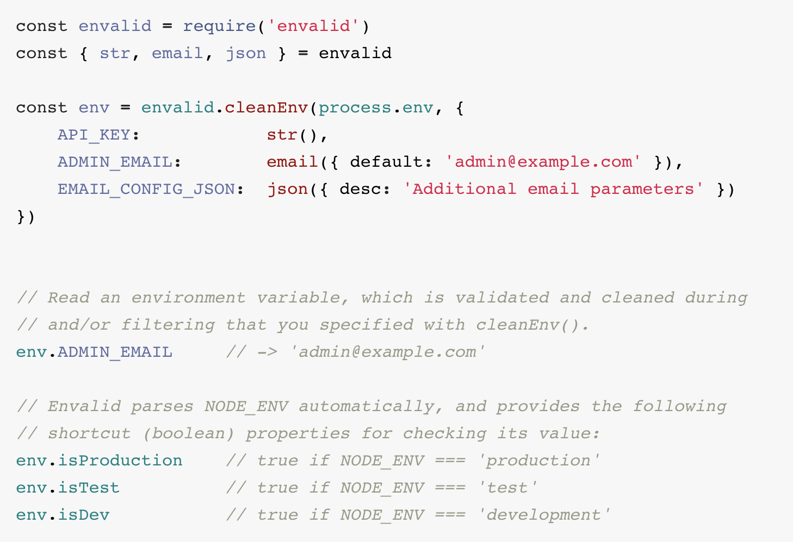
3. Config
Store config in the environment
Use dotenv to load config from .env files
Use envalid to validate and document Env Variables

Slide 18
4. Backing services
A backing service is any service the app consumes over the network as part of its normal operation.

Slide 19
4. Backing services
Examples
Datastores
GraphQL Server
Messaging/Queueing Systems
Third Party Systems
SMTP Services
API

Slide 20
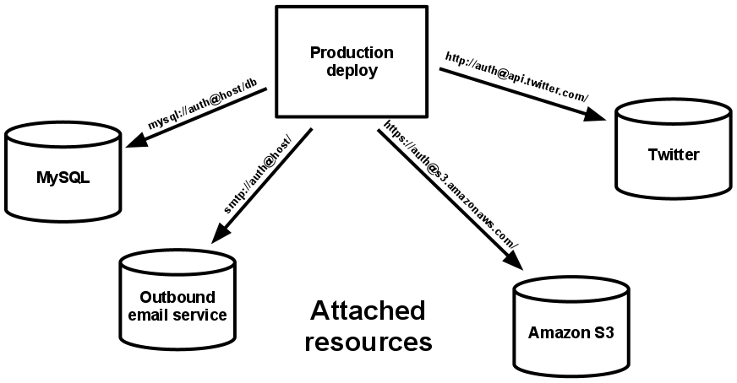
4. Backing services
Treat backing services as attached resources
Each distinct backend service is a resource
local ≡ third party services
Each resource is replaceable

Slide 21
5. Build, release, run
A codebase is transformed into a (non-development) deploy through three stages: build, release and run.

Slide 22
5. Build, release, run
Build Stage
A transform which converts a code repo into an executable bundle known as a build

Slide 23
5. Build, release, run
Release Stage
Takes the build produced by the build stage and combines it with the deploy’s current config.

Slide 24
5. Build, release, run
Run Stage
Runs the app in the execution environment, by launching some set of the app’s processes against a selected release.

Slide 25
5. Build, release, run
Strictly separate build and run stages
Strict separation between the stages.
Every Release - Unique Release ID
Releases are Immutable
Run stage - automated
Run stage should be kept simple

Slide 26
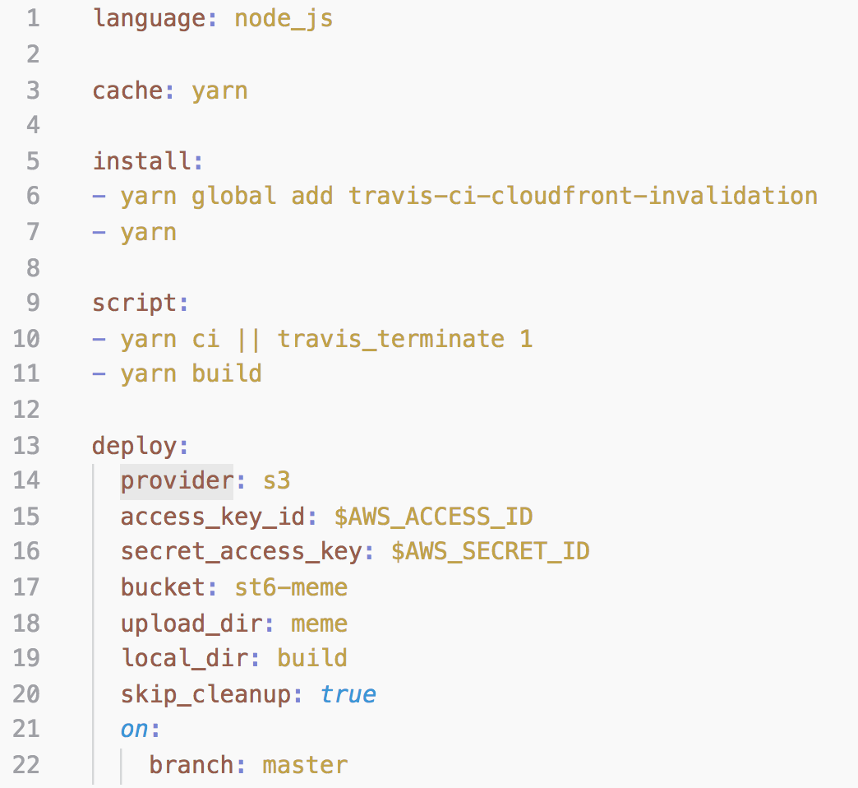
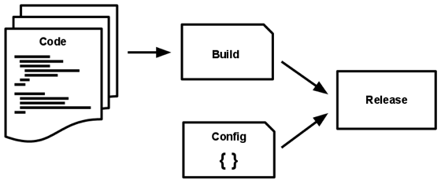
5. Build, release, run
ST6 Meme Generator*

Slide 27
6. Processes
Execute the app as one or more stateless processes
Processes are stateless
Process share nothing
Memspace or filesystem can be used as single-transaction cache
Never rely upon cache

Slide 28
7. Port binding
Export services via port binding
Completely self-contained
Exports HTTP as a service by binding to a port

Slide 29
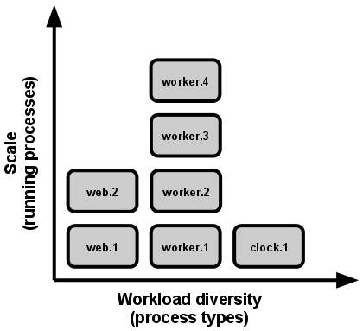
8. Concurrency
Scale out via the process model
Processes are first-class citizens
Vertical Scaling
Horizontal Scaling

Slide 30
9. Disposability
Maximize robustness with fast startup and graceful shutdown
Processes are disposable
fast elastic scale
rapid deployment
robustness of production
Strive to minimize startup time
Shut down gracefully
Robust against sudden death

Slide 31
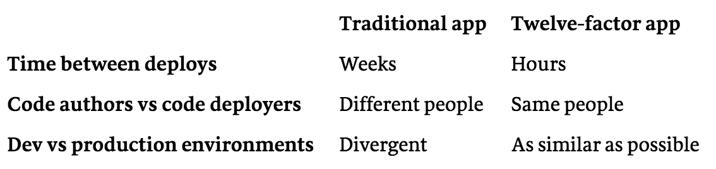
10. Dev/prod parity
Keep development, staging, and production as similar as possible
Designed for CD
Same backing services between development and production

Slide 32
10. Logs
Logs are the stream of aggregated, time-ordered events collected from the output streams of all running processes and backing services.

Slide 33
11. Logs
Treat logs as event streams
Never concerns of routing or storage of the stream
Execution environment takes care of the stream

Slide 34
12. Admin processes
Run admin/management tasks as one-off processes
Run in an identical environment as the regular long-running processes of the app
Must ship with application code to avoid synchronization issues
Use same isolation techniques

Slide 35
React Best Practices

Slide 36
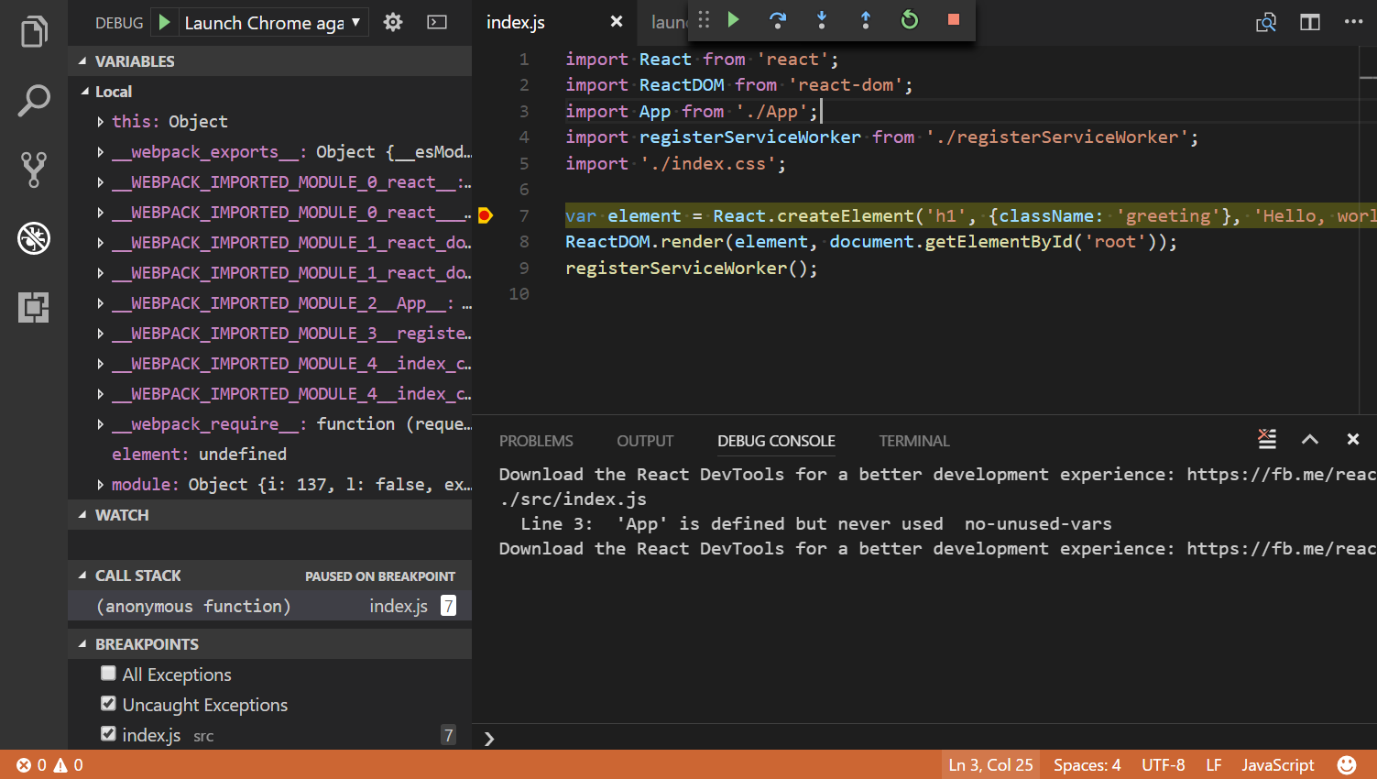
Setup IDE
Install Extensions/Plugins
Configure Debugger*

Slide 37
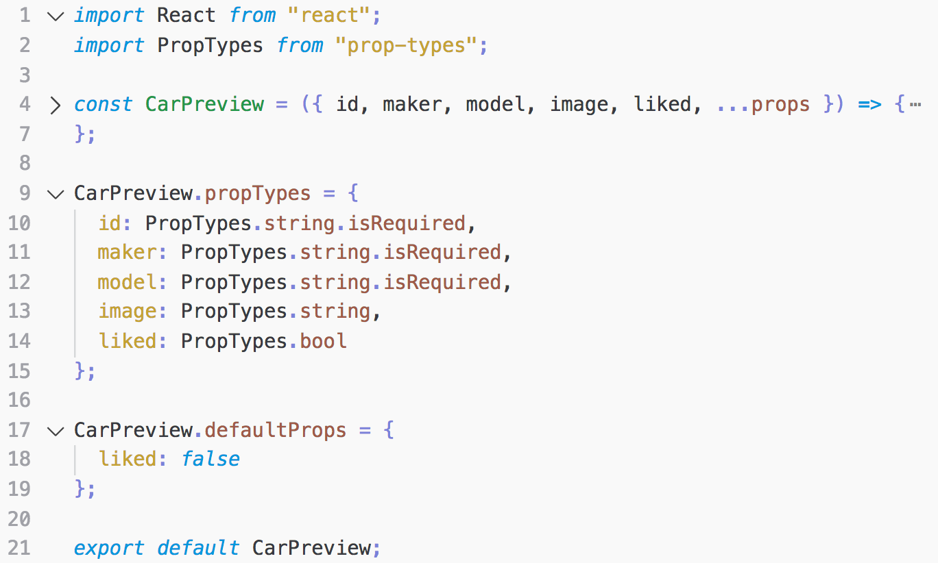
Use PropTypes
Document Expected Props’ Types
Validate Expected Props
Set Default Values*

Slide 38
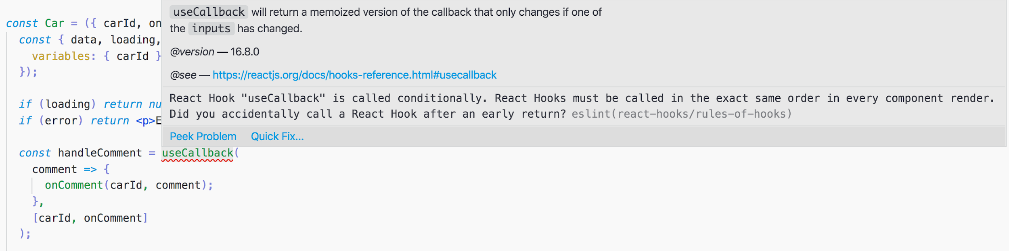
Use Linters
Code Consistency
Prevents Runtime Errors
Enforces Good Practices
Decreases Team Friction

Slide 39

Code-Snippets
Speeds up development
Keeps code consistent
Project-specific snippets
Doesn’t have to remember the little things
Limits typing mistakes

Slide 40

Code-Snippets
Speeds up development
Keeps code consistent
Project-specific snippets
Doesn’t have to remember the little things
Limits typing mistakes

Slide 41
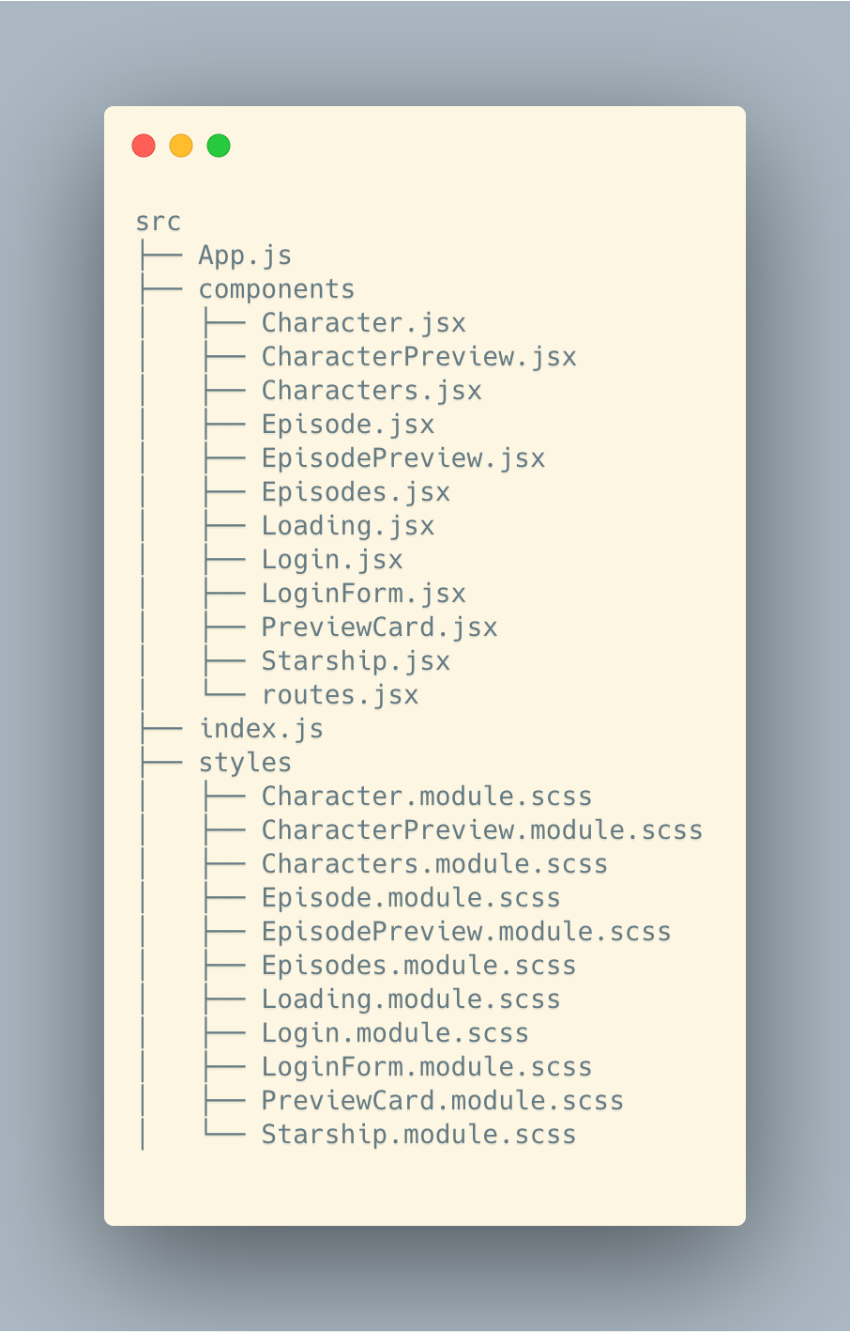

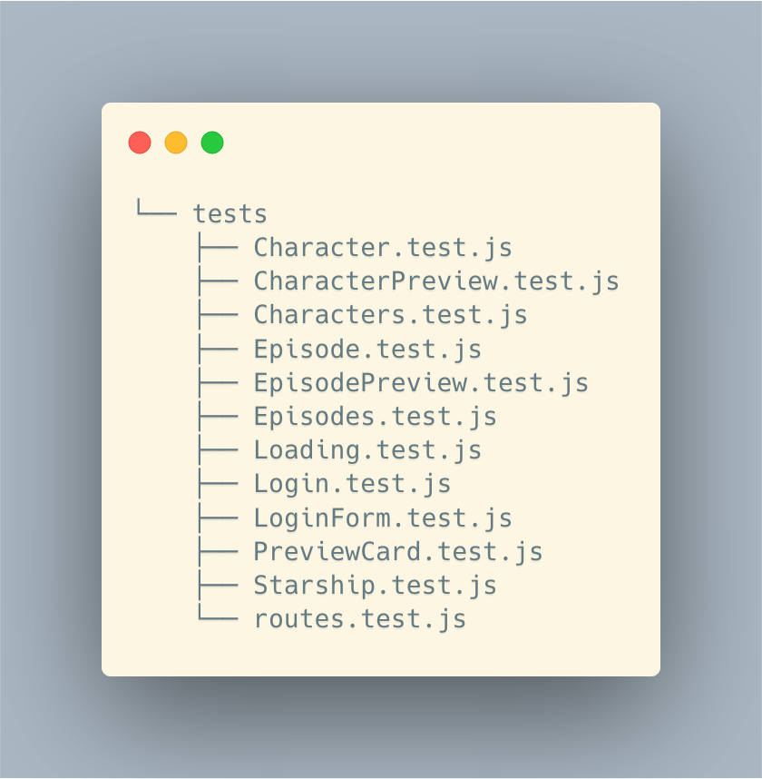
Directory Layout

Slide 42
Directory Layout
Common Components in a Separate Module
Tests and Styles next to Component that use them
Component as a Directory
Different “domain” components in own directories

Slide 43
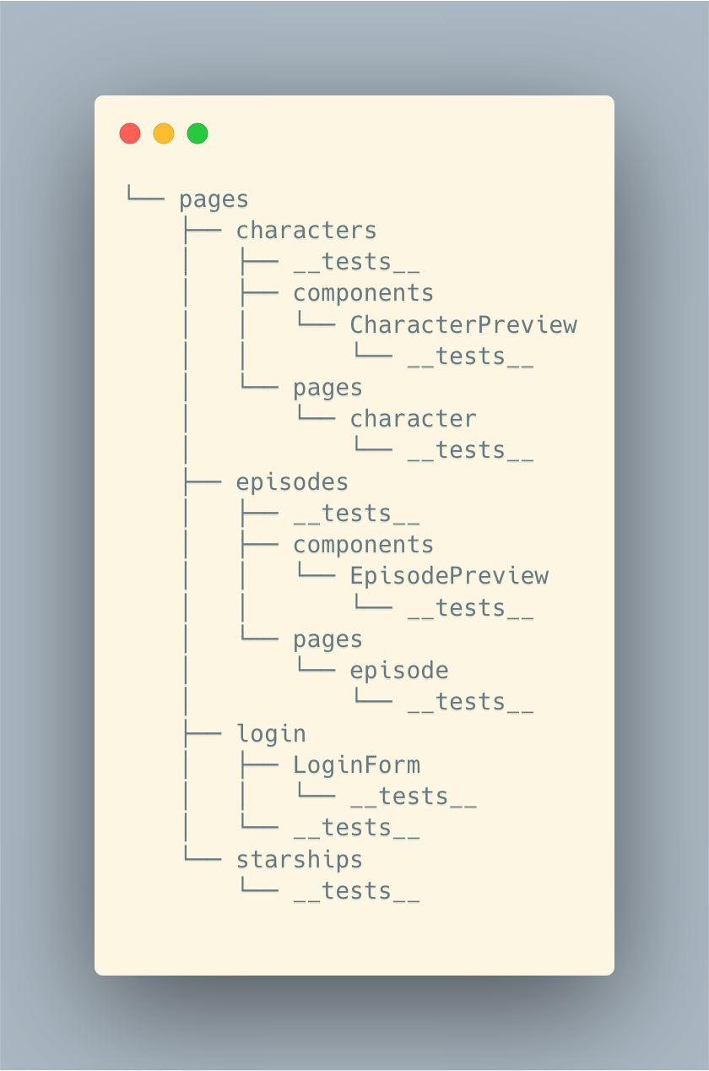
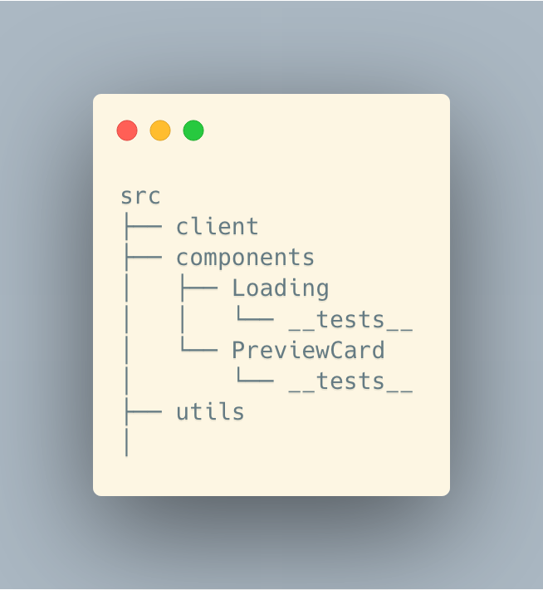
Directory Layout
Source Folders Tree

Slide 44
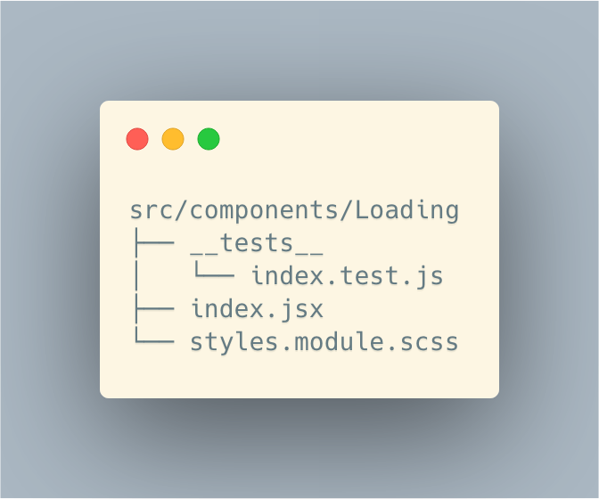
Directory Layout
Loading Component Tree

Slide 45
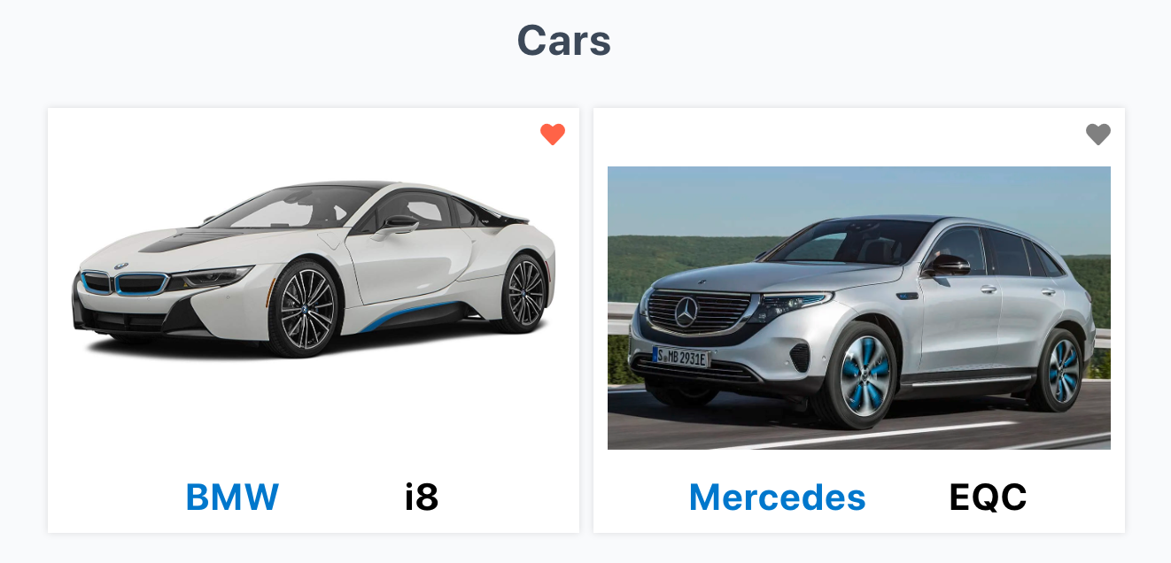
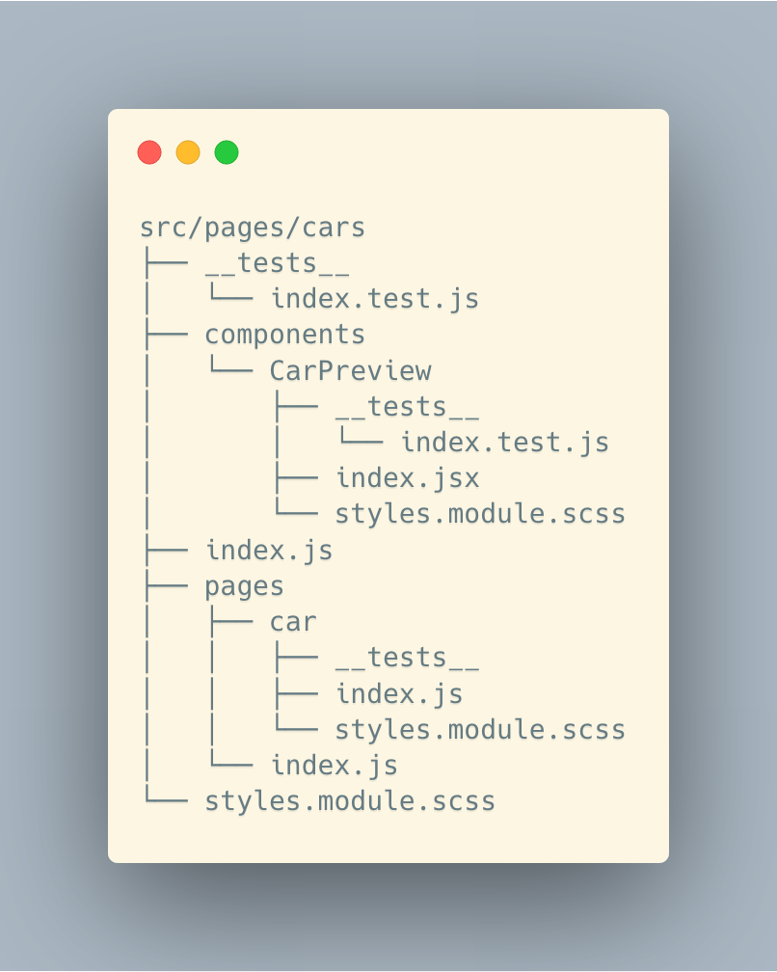
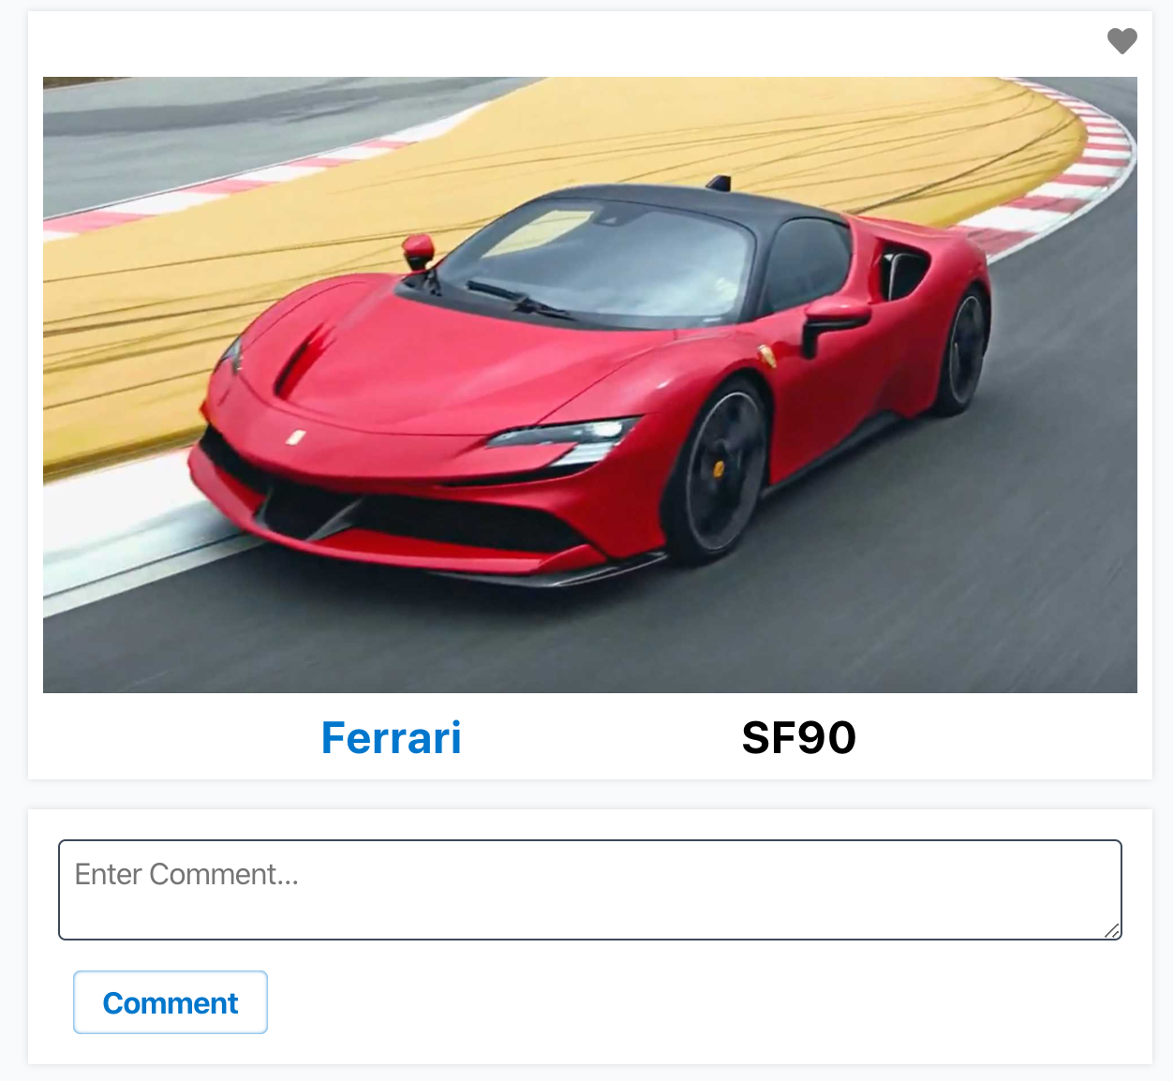
Directory Layout
Characters Module Tree

Slide 46
Small and Function-Specific Components
Do one and only one thing
Easy to Reuse
Separation of Concerns
If you can’t generalize what component does with single simple sentence, it probably does too much, e.g.:
Queries starship data and calculates starships stats
Queries starship data;
Calculates starships stats;

Slide 47
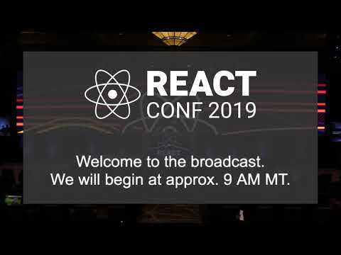
Composition, composition, composition
Start with Generic Components
Add Components not Properties
Extract Components not Functions

Slide 48
Test are your workouts
You may not like doing them, but they help you in the long run.
Easy Tests ≡ Simple Components
Exhaustive Tests ≡ Robust Application
Beautiful Tests ≡ API Documentation

Slide 49


Slide 51






СофтУни диамантени партньори

Slide 52






СофтУни диамантени партньори

Slide 53





Trainings @ Software University (SoftUni)
Software University – High-Quality Education, Profession and Job for Software Developers
softuni.bg
Software University Foundation
http://softuni.foundation/
Software University @ Facebook
facebook.com/SoftwareUniversity
Software University Forums
forum.softuni.bg

